Slide 1
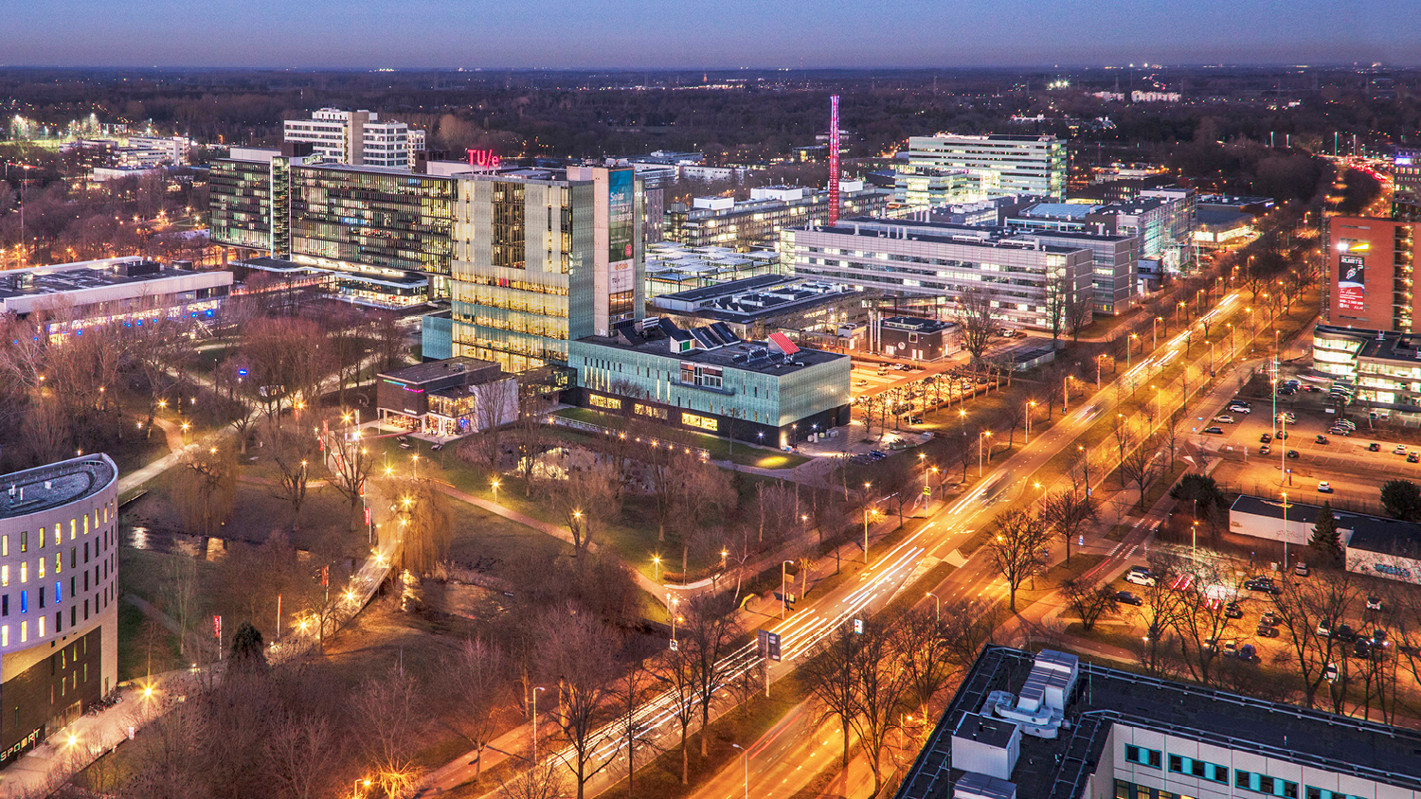
Integration of Environment Manipulation within the Navigation Topology:
Bachelor End Project – 05/07/2022
Ismail Elmasry, Bachelor Candidate
Department of Mechanical Engineering, Control Systems Technology group, Tech-united@home

Slide 2
Outline:
Current Navigation Stack Architecture
Problem Formulation
Assumptions and Simplification
Performance Measures
Conceptualization
Implementation
Experimental setup & Results
Future work
Conclusion

Slide 3
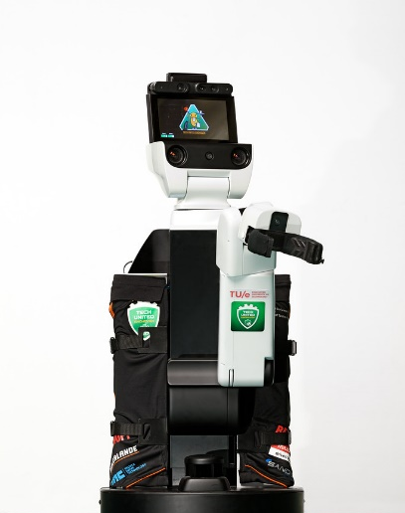
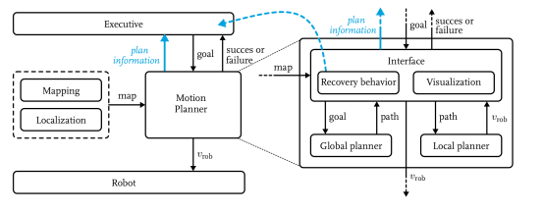
Current TU/e Navigation Stack For Hero
A Hierarchical motion planning system which consists of:
Global Planner: provides connectivity information to the global goal with the use of an A* search algorithm.
Local planner: The steering commands are made using DWA
Executive : A general state machine which provides goals to the motion planner. The recovery behavior is also implemented in this module as it knows more information about the world and the task being executed.

Slide 4
Problem Formulation

Slide 5
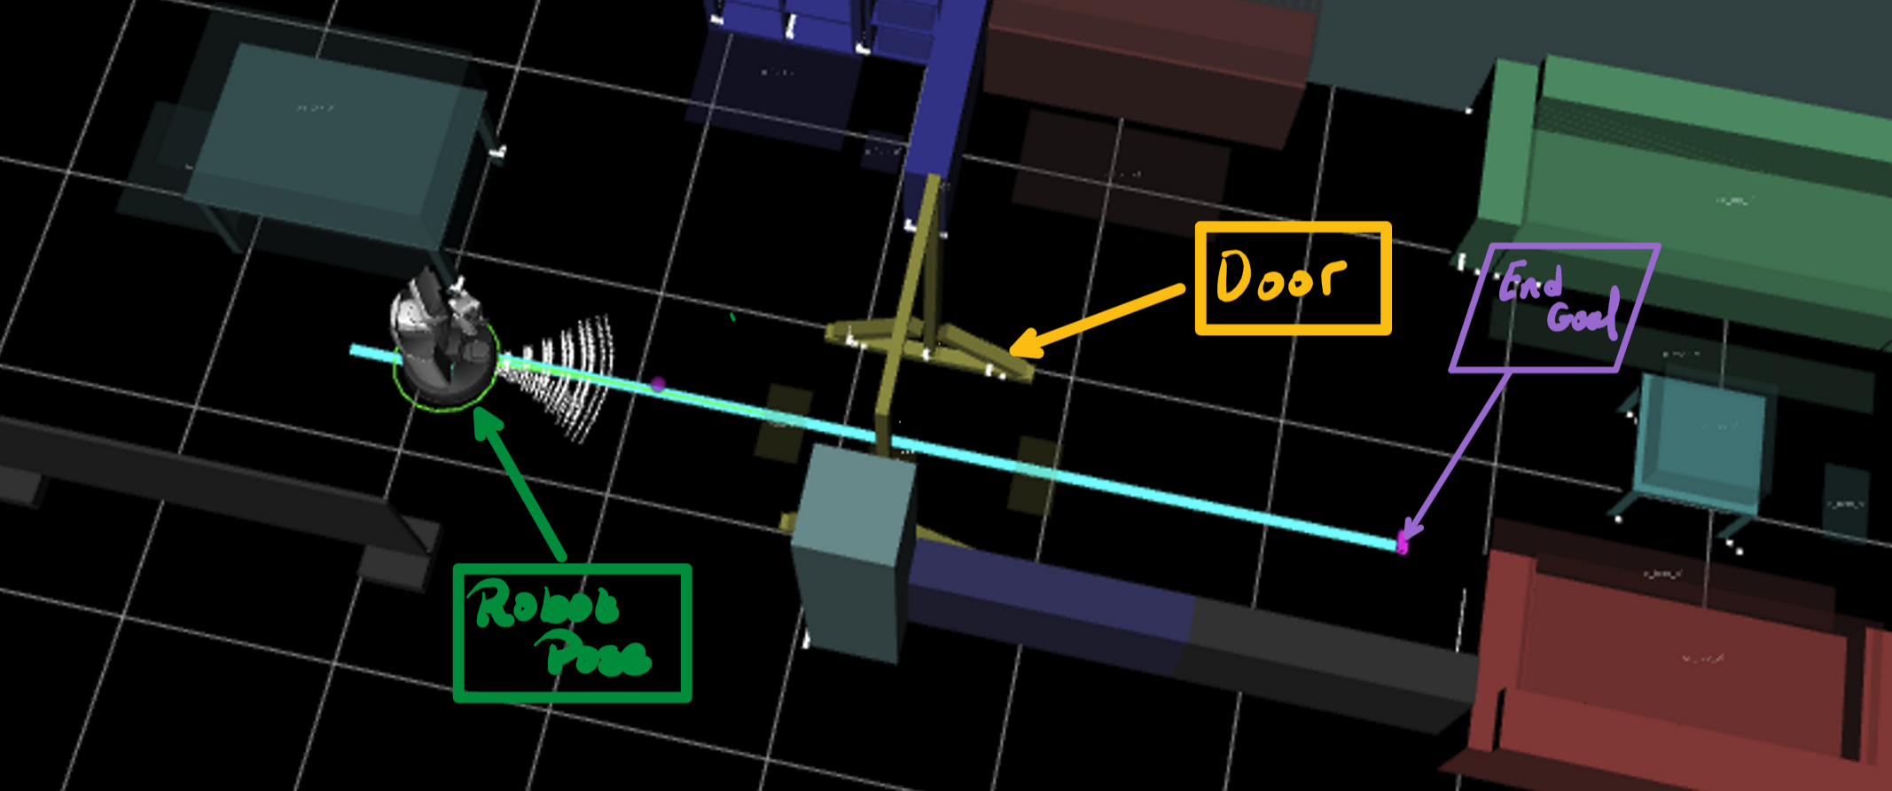
Problem Formulation (Door opened)
Notes:
NAMO problem; NP-hard for simple case
computational complexity theory, NP-hardness is the defining property of a class of problems that are informally "at least as hard as the hardest problems in NP"

Slide 6
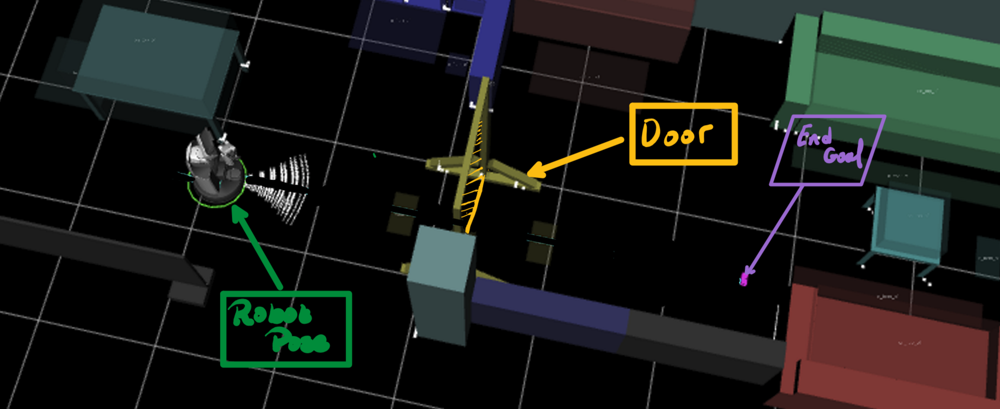
Problem Formulation (Door closed)

Slide 7
Problem Definition
Design and implement a planner which combines motion planning and object manipulation, using geometric and symbolic information from the world model to allow navigation among movable objects in domestic environments.

Slide 8
Assumptions and Simplifications:
Robot can manipulate Known objects by pushing at set contact points.
Robot is the only autonomous entity in the environment.
Robot can detect dynamic obstacles.
The dynamic obstacles are placed in the environment in such a way to ensure linearity of the problem.

Slide 9
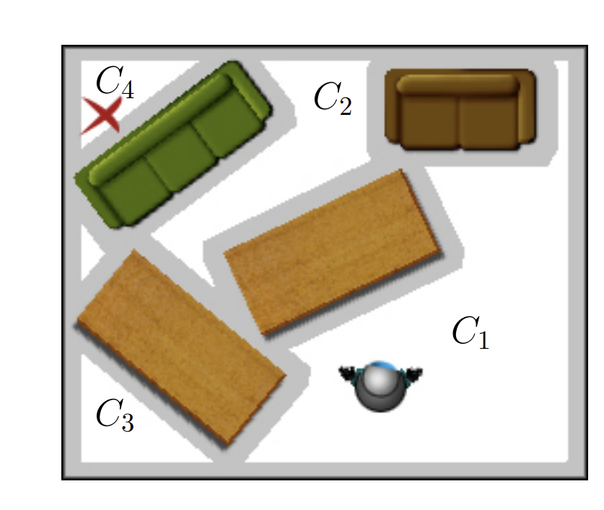
Problem Linearity
A problem is Linear if there exists a sequence of independent objects that could be moved to connect two disjoint components of the free configuration space.(no cascading effect)
Figure: Sequence of objects blocking path (Stilman et al.[2004]):

Slide 10
Performance Measures
1. Generates the path with the shortest distance.
2. Uses the least amount of work.
3. Can adapt to different blocking locations along the path.
4. Can adapt to different object dimensions and orientations blocking the path.
5. Can differentiate between static and dynamic obstacles.

Slide 11
Conceptualization

Slide 12
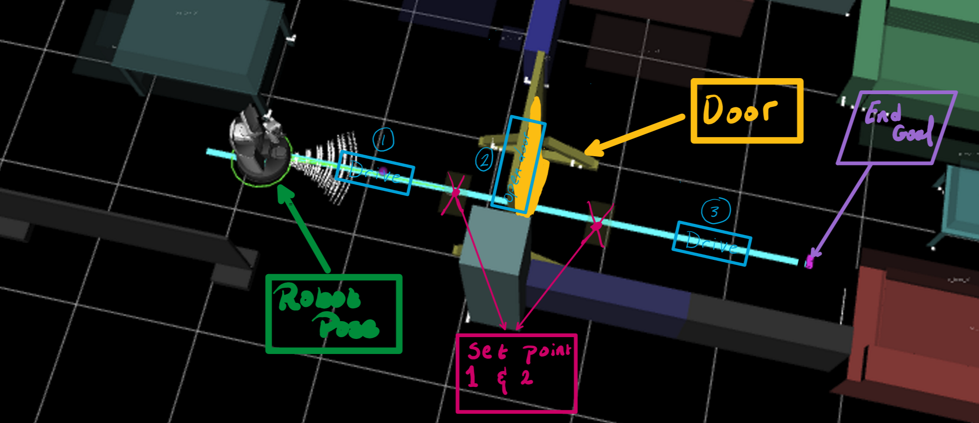
Conceptualization -1- Set Point Definition

Slide 13
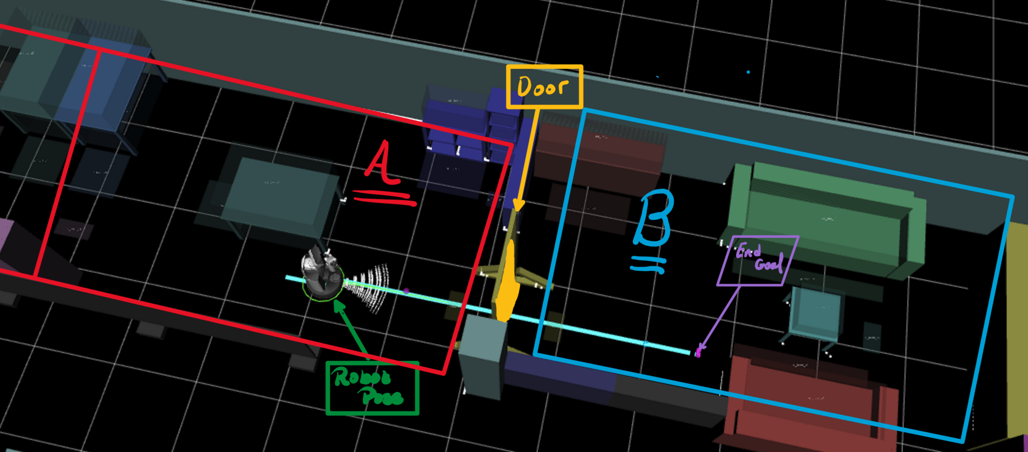
Conceptualization -2- Configuration Space Partitioning

Slide 14
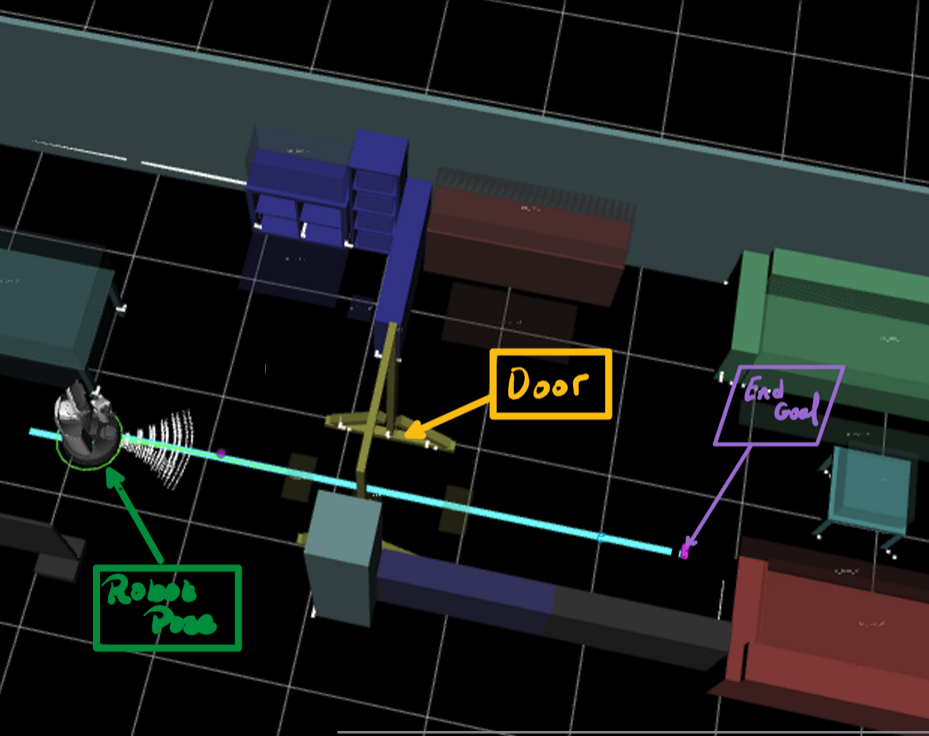
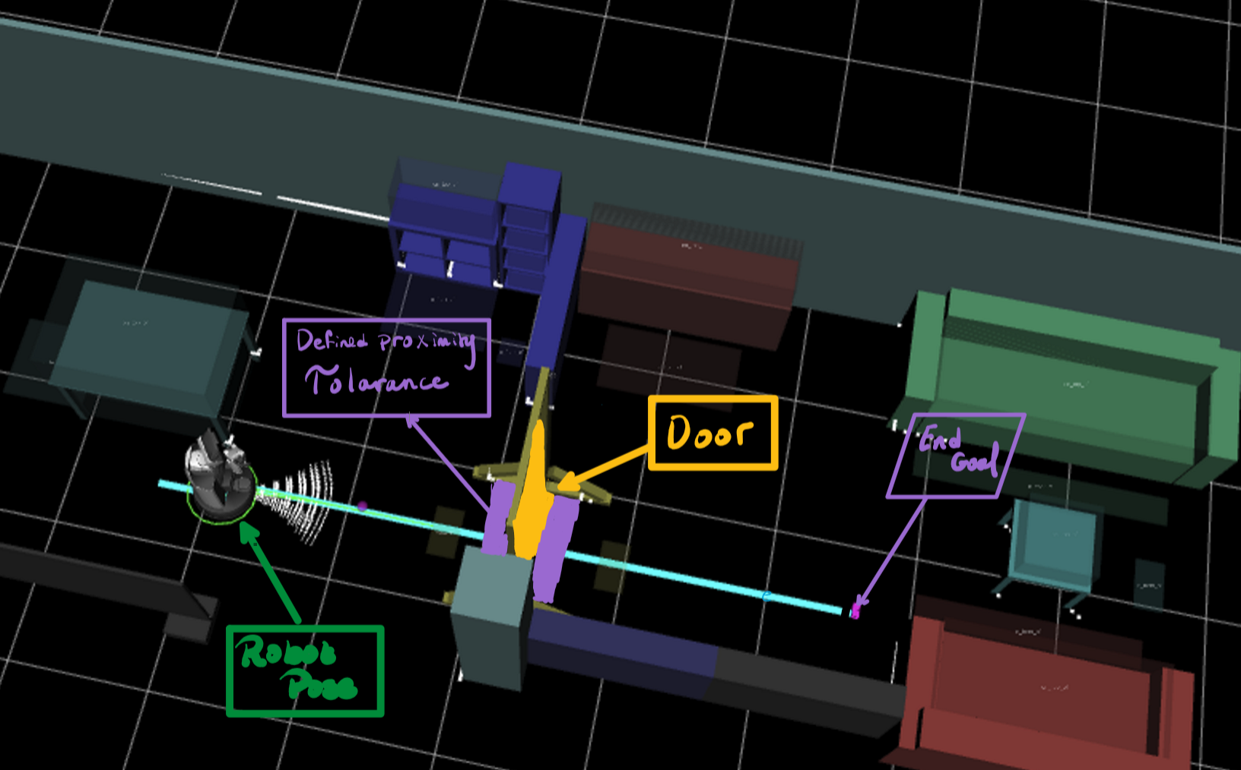
Conceptualization -3- Global & Local Map Seperation

Slide 15
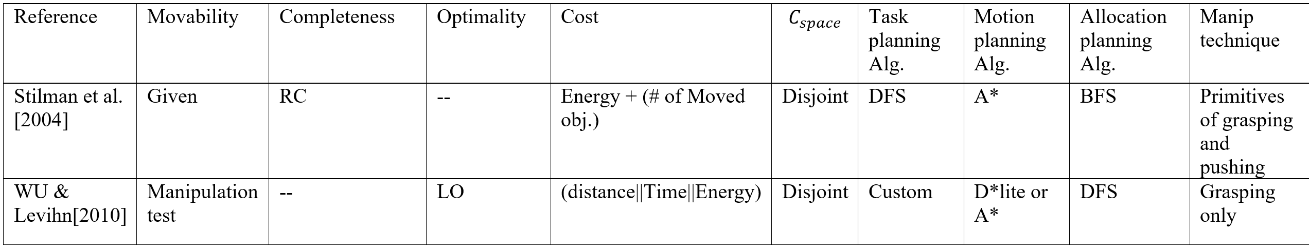
Stilman et al. [2004] Approach:
WU & Levihn [2010] Approach:
Utilizes the concept of connecting disjoint configuration spaces.
Applies grasping and pushing manipulations based on predefined setpoints.
Utilizes the concept of Map separation to find objects blocking path.
Applies manipulation by dividing navigation path into 3 sub edges.
Notes:
n algorithm intended to locate a local optima. It is suited to traversing a given region of the search space and getting close to (or finding exactly) the extrema of the function in that region.
If a path exists, it finds it in finite time. – If a path does not exist, it returns in finite time. Start. Goal.

Slide 16
Implementation

Slide 17
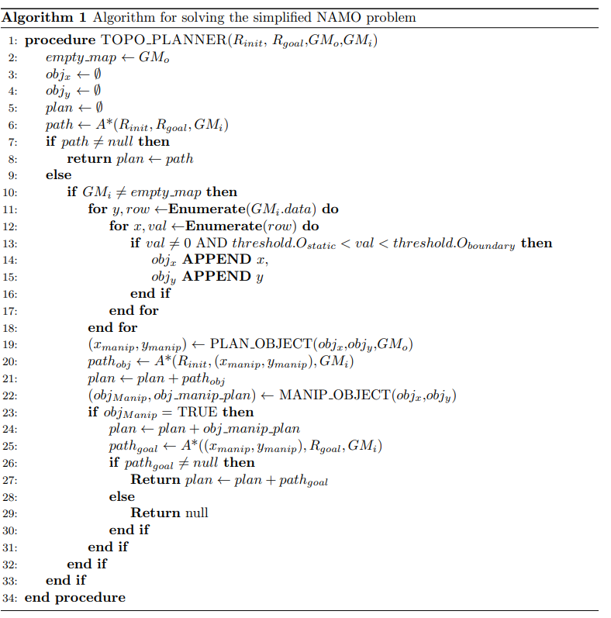
Pseudocode Implementation:

Slide 18
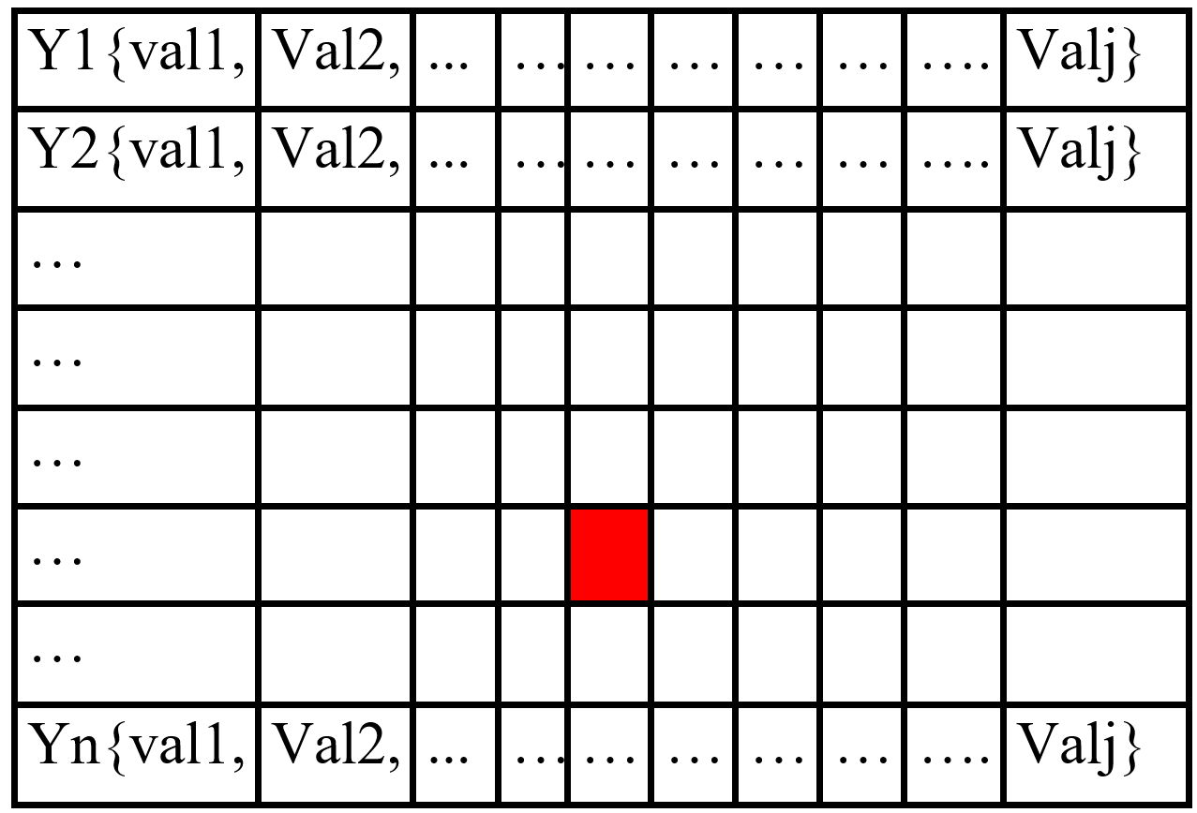
Pseudocode Implementation:
Enumerate():
Where is the dynamic object?
PLAN_OBJECT():
Which object to manipulate?
MANIP_OBJECT():
How to manipulate and is it removed?

Slide 19
Experimental Setup & Results

Slide 20
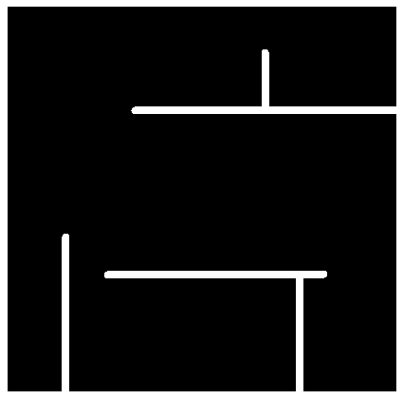
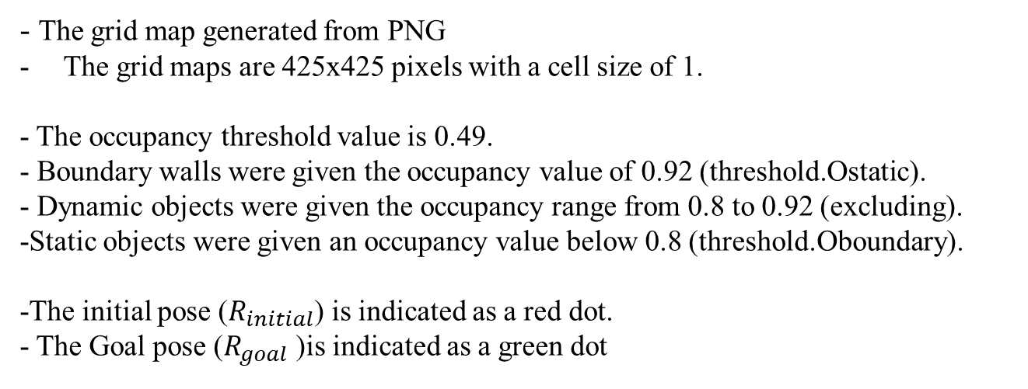
Experimental Setup:
- The grid map generated from PNG
The grid maps are 425x425 pixels with a cell size of 1.
- The occupancy threshold value is 0.49.
- Boundary walls were given the occupancy value of 0.92 (threshold.Ostatic).
- Dynamic objects were given the occupancy range from 0.8 to 0.92 (excluding).
-Static objects were given an occupancy value below 0.8 (threshold.Oboundary).
-The initial pose ($R_{initial}$) is indicated as a red dot.
- The Goal pose ($R_{goal}$)is indicated as a green dot

Slide 21
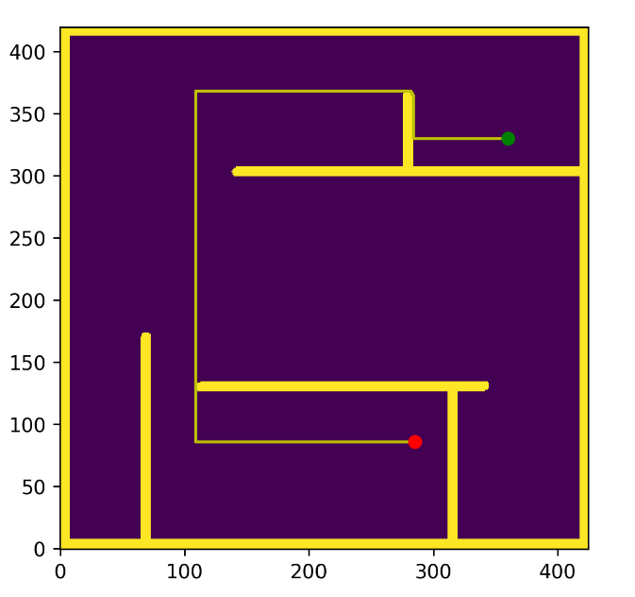
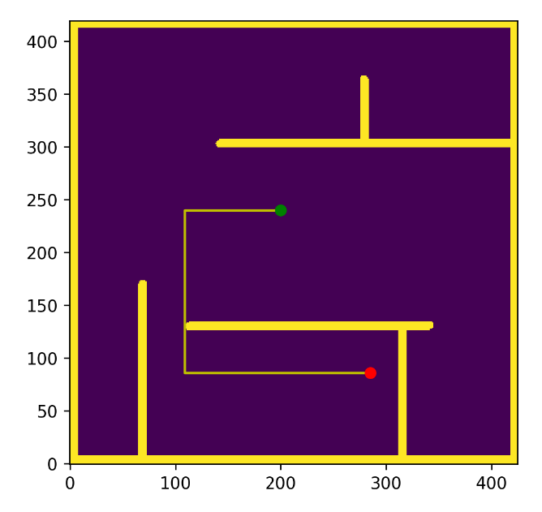
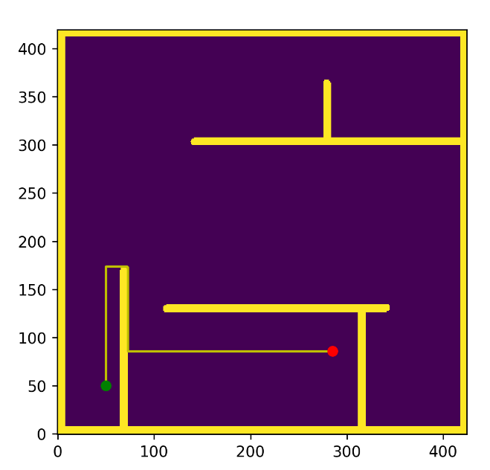
Scenario -1- No constraining object
Goal pose 1: (360,330)
Goal pose 2: (210,240)
Goal pose 3: (50,50)

Slide 22
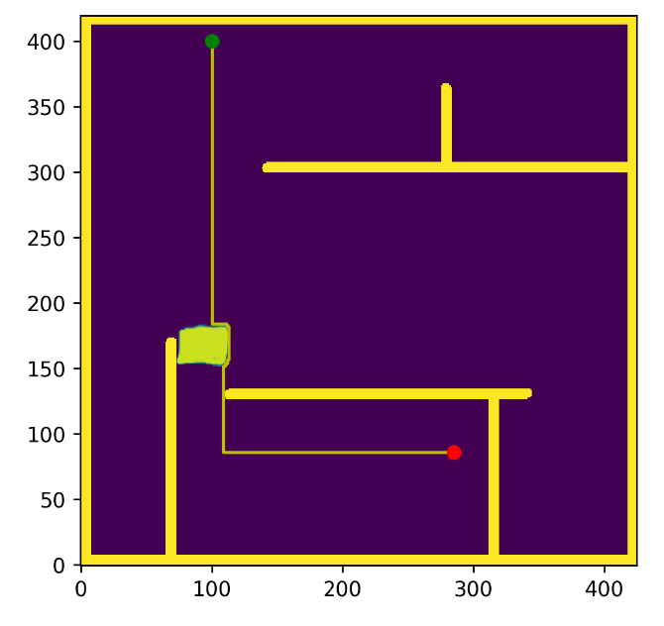
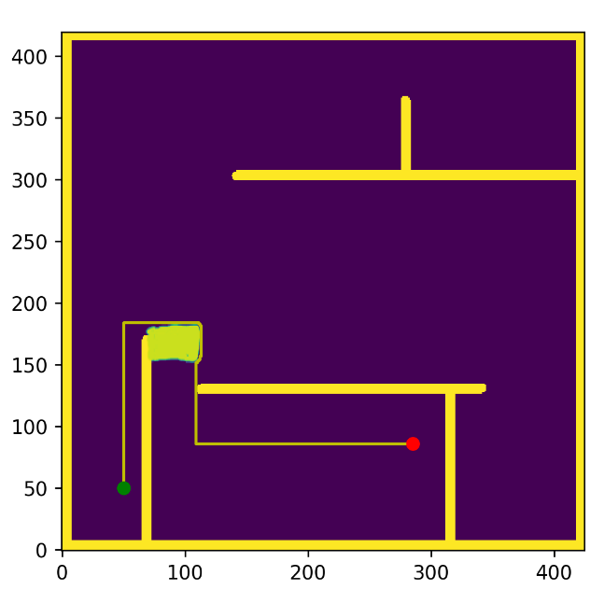
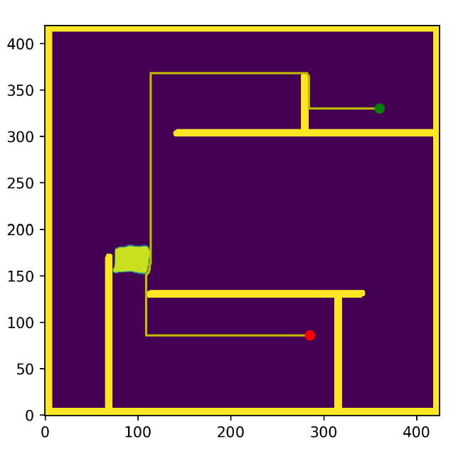
Scenario -2- Constraining Object not blocking path
Goal pose 1: (100,400)
Goal pose 2: (50,50)
Goal pose 3: (360,330)

Slide 23
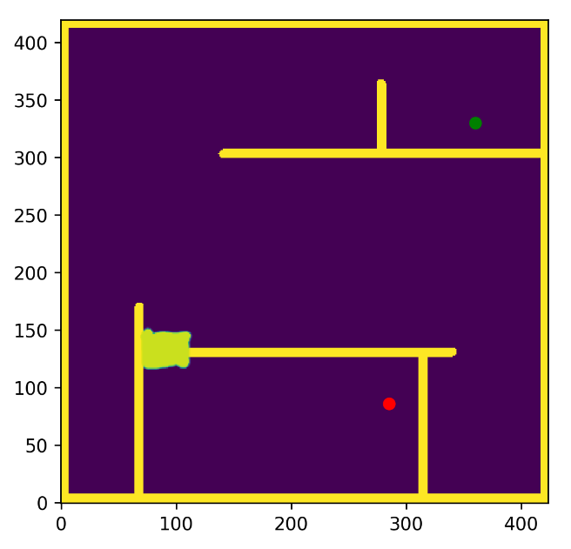
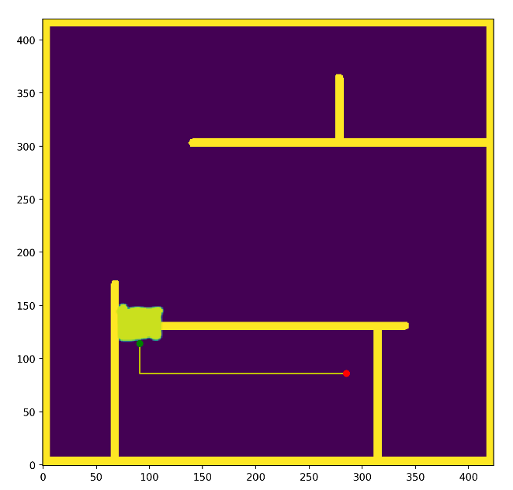
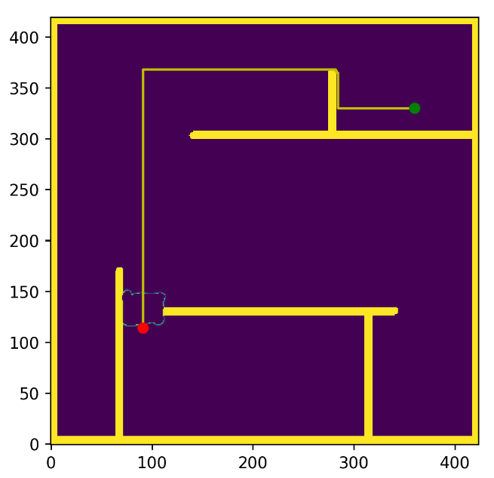
Scenario -3- Constraining Object Blocking Path
b) Navigated to dynamic object and attempting manip.
a) Dynamic object detected
c) Navigation to goal pose

Slide 24
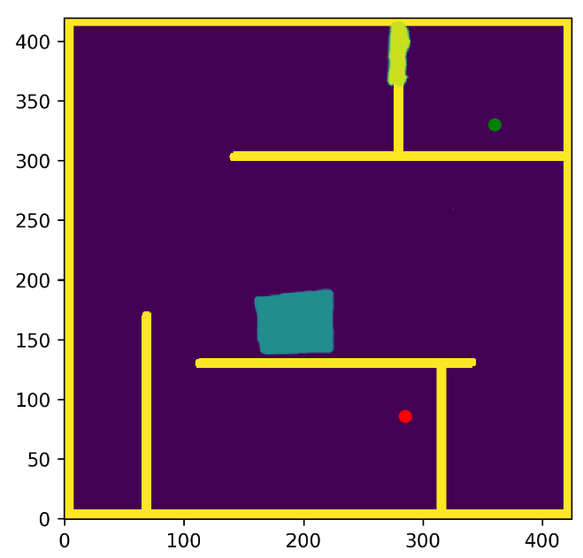
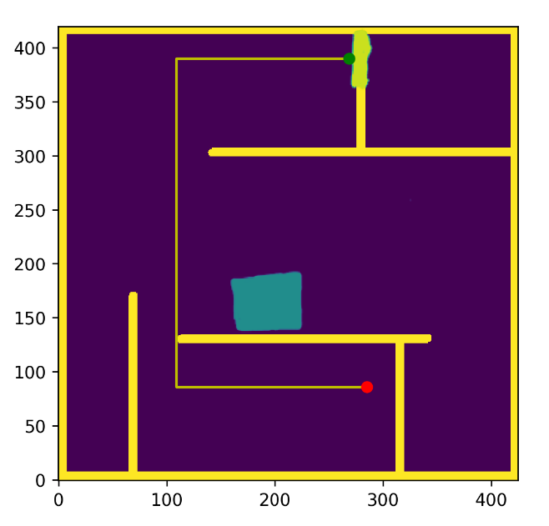
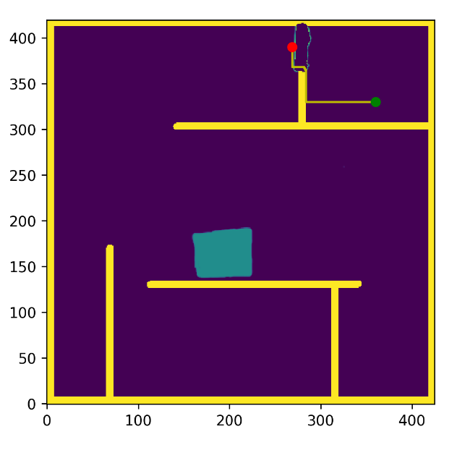
Scenario -4- Constraining Object at different location
b) Navigated to dynamic object and attempting manip.
a) Dynamic object detected
c) Navigation to goal pose

Slide 25
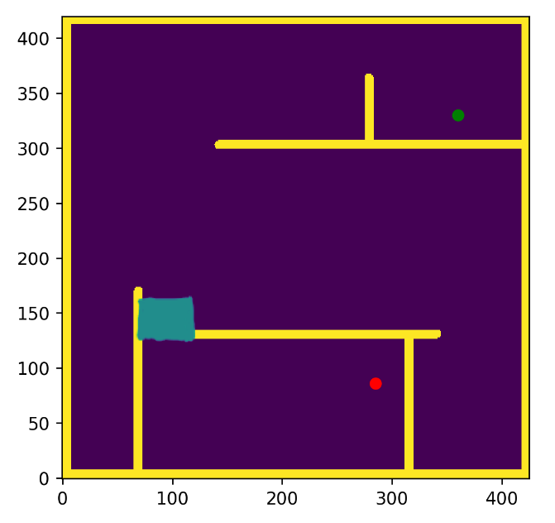
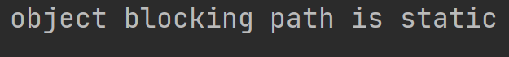
Scenario -5- Static Constraining Object
a) Static object blocking path
b) Return message

Slide 26
Future Work

Slide 27
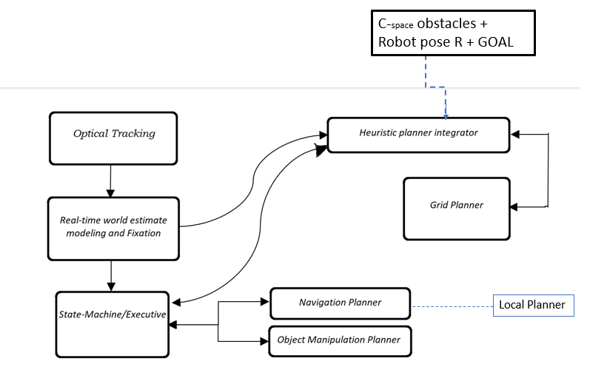
Future Work and Extensions
Object placement planning
Object Manipulation
More than one dynamic obstacle classification.
Updating the Navigation Stack architecture for real life testing
Figure: Updated the Navigation stack architecture

Slide 28
Conclusion:
Generates the path with the shortest distance.
Uses the least amount of work.
Can adapt to different blocking locations along the path.
Can adapt to different object dimensions and orientations blocking the path.
Can differentiate between static and dynamic obstacles.
Locally optimal

Slide 29

Thank you!

